Slide 1

ADE Data on Demand LatentView Proposal
Aug 2018

Slide 2
Agenda
1
About LatentView
2
Walmart Current Architecture & Evaluation
3
Key Asks For Project Delivery
4
Workplan, Engagement Model and Commercials
5
LatentView’s POV on Evolving Architecture For Diverse Analytical Workloads
6
LatentView’s Data Engineering Capabilities

Slide 3


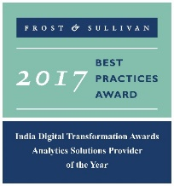




LatentView – A World Class Analytics Company
Awards & Recognition
Founded in
Over
Grown
Work with
Strong Performer - Customer Analytics Services, 2017
600
11
30+
2006
People strong
times in last
six years
Fortune 500
firms
Repeat business at
Member of
2009-2017
Technology council
Rated as Top
10
5%
4/5
>85%
Repeat
business
Analytics companies to work for in India
Re-investment in Research and Development
Top technology companies engage with us

Slide 4








End to End Expertise – High level view
Functional categories
Enablers
Customer Analytics
Marketing Analytics
Supply Chain
Finance And Risk
HR Analytics
CFO Dashboards
Employee Pulse and Retention
Customer Perception
Brand and Competitive
Positioning
Sourcing and
Replenishment
Customer Behavior
Collection Analytics
Talent Acquisition
Campaign Design and Effectiveness
Metrics
Measurement
Trust/Counterfeit
Analysis
Performance and Compensation
Lifetime Value Analysis
Marketing Spend Optimization
Demand-Supply Forecast
Loyalty and Personalization
Attribution Modelling
Inventory Optimization
Personalized Marketing
Innovation
Administration
Cross Sell/Up Sell
End to End Visibility
Innovation Radar
Asset Optimization
Data Engineering
Business-focused Approach to Data Engineering to help adopt modern scalable architectures
Visualization
Reporting and dashboards platforms for Insights and quick view on KPIs

Slide 5





Driving Business Benefits through Data
Extracted and analyzed unstructured data to measure customer feedback, purchase drivers vis-à-vis competition
Built a cloud based data platform which supports reporting and advanced analytics solutions
Hypothesis Testing Tool to identify driving styles based on vehicle usage to accurately predict future warranty claims
SmartInsights platform for spotting trends, rating influencers and understanding drivers of purchase in the cosmetics industry
Automated campaign management platform (LVM) to enable dynamic selection of best offers and messages for each customer based on their life stage
Predictive Modeling and Advanced Diagnostic Analysis to improve service levels for home appliances repair

Slide 6




Snapshot of Select Projects : Data Engineering
Other examples of LatentView’s Data Engineering Expertise
Warner Bros
Hitachi Vantara
Built a high throughput, high volume clickstream data pipeline that enables a 360 degree view of the customer and helps product teams to see deep in to what drives user behaviour and how they can impact it.
Drives 1/3 of all business insights
Complex queries with sub minute response on TBs of data
10x faster than conventional setup
Provisioned cloud based scalable infrastructure and seamlessly migrated and enabled access of existing VPC’s, Subnets, IAM Users & Roles, Environments, Dashboards etc. supporting the digital supply chain processes for Home Entertainment
Enabled fast analytical querying, particularly on large datasets
Ensured on-time delivery of the digital contents resulting in $500K annual savings
Assessed existing data & reporting architecture of organization and redesigned the architecture and KPI framework inline with business objectives along with a detailed analytics roadmap for the organization.
Analytics Roadmap
Business & Analytics aligned architecture
Consulting on the ongoing implementation\

Slide 7
Current Architecture and Evaluation

Slide 8
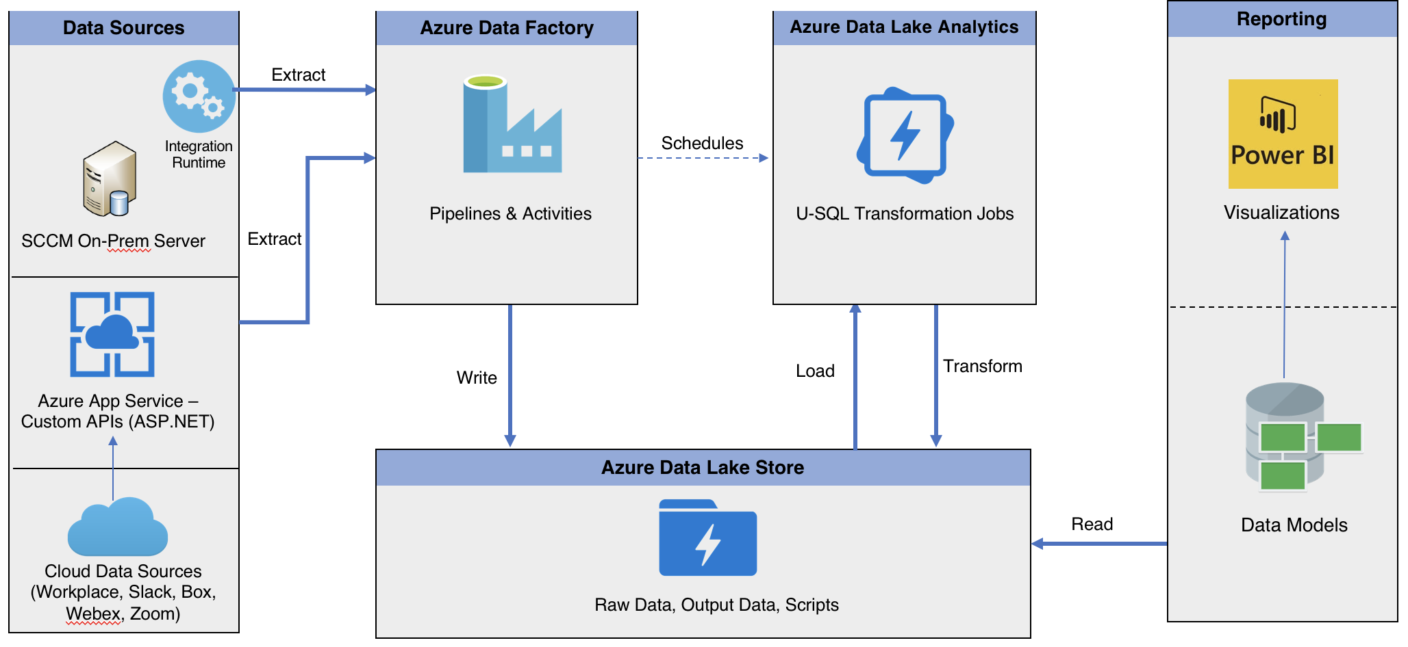
Walmart Current POC Architecture
* As shared by Walmart

Slide 9
Walmart Current POC Architecture - Evaluation
Discovery required for analyzing sources, refresh frequency, reporting requirements
Customizations might be required for diverse sources
Existing Jobs – Not thoroughly evaluated for scale
Discovery required for reporting dashboards specific to business
Report on
Data QA
& Integrity
To be designed based on reporting requirements
Data Storage format and compression to be evaluated for optimal consumption

Slide 10
Key Asks For Project Delivery

Slide 11
Key Asks For Project Delivery
Transition team required for on–going implementation sprints from POC to production
Leverage code & design from POC phase to minimize lead time to production
Perform due diligence and discovery to identify business specific reporting requirements
Identify corresponding data sources to meet business requirements
Review existing data transformations to accommodate changes required
Code & Process documentation for effective knowledge transfer
Propose an extensible solution for diverse analytical workloads at scale
Walmart Team to support on
Access to appropriate systems and services
Help evaluate reporting requirements and mapping to data sources
Support in setting up, deployment, testing and productionizing work

Slide 12
Work-plan, Engagement Model and Commercials

Slide 13
Project Timelines
We intend to adhere to Walmart internal sprint plans in continuous delivery and iteration. The estimate proposed below is tentative and subject to reprioritization based on inputs
Interim Milestone for review & feedback
Activity | Estimated Timeline
 | Sprint 1 |  | Sprint 2 |  | Sprint 3 |  | Sprint 4 |  | Sprint 5 |  | Sprint 6 |  | Sprint 7
 | Week 1 | Week 2 | Week 3 | Week 4 | Week 5 | Week 6 | Week 7 | Week 8 | Week 9 | Week 10 | Week 11 | Week 12 | Week 13 | Week 14
Access set up for onsite and offshore to Azure system and services
Reporting requirements and required data model , Access control lists
Identify data sources , limitations and optimizations for internal review
Reporting dashboard wireframe & review with test data |  |  | 4 data sources |  | 4 data sources |  | 4 data sources |  | Additional data enhancements
Design data pipelines for all required sources, customizations
SLA bound Pipeline Orchestration & Dependency Management
Data Model design; alignment with ETL design |  |  | Review Path to Production |  | Review and Production Rollout |  | Review and Production Rollout |  | Review and Production Rollout |  | Review and Production Rollout
Capturing data in a staging environment & data mart in optimized formats
Aggregate data models to enable analytics reporting & for business consumption, build and iterate on reports/dashboard
Data quality scoring: Log all activities, data & analyze quality of process
Enforce, track & audit the prescribed ACLs, SLAs & schedules
Document code and process flow, metrics lineage
Review Data Pipelines, QA and Data Integrity |  |  |  |  |  |  |  |  |  |  |  |  | Production Support
Review output dashboard and respective functionalties
Discovery
Data Pipelines
(Using Existing Design)
Data Mart
Governance
UAT

Slide 14
Risk Mitigation Plan
Following risks are likely to cause time and budget overruns. We will implement a robust risk avoidance and mitigation plan.
Risk Factors | Severity | Probability | Pro-active Avoidance & Mitigation Plan
Unforeseen complexity of some metrics; dynamic changes in metric granularity | Medium | High | LV will leverage manual & automated methods to expedite the process; Additional buffer already added to the schedule to allow for such slippages
Lack/ delay in consensus on single metric definition | Medium | High | Additional buffer has been added to the schedule to allow for such slippage
Delay in access to documentation on previous analyses of key metrics, data sources, & reports that may require SME outreach; unavailability of SMEs | High | Medium | LV will call out gaps immediately & work with Walmart POC to selectively connect with relevant SMEs for quick turnaround
Mid-project change of scope e.g. inclusion of more metrics or additional deliverables | High | Medium | LV will provide recommendations; will get expedient sign off from Walmart POC
Delay in required access privileges to tools, platforms, databases/ tables/ schemas in Walmart environment | High | Medium | LV will work with Walmart team to expedite the process
Unplanned & unexpected system downtimes | High | Medium | LV will work with Walmart team to find workarounds and continue development in local environments
Delay in receiving work authorization for onsite resources | Medium | Medium | LV will prioritize staffing resources already possessing US work permits; if required premium visa processing of Visas will be done for additional resources
Resource & skill set mismatch and performance concerns | High | Low | LV will review the concern and support the project execution with appropriate resources from the additional buffer
Lack of timely review, feedback and approval by Walmart Point of Contact (POC) | Medium | Low | Additional buffer has been added to the schedule to allow for such slippage
Delay in procurement of requisite licenses for any third-party tools and products | Medium | Low | To expedite matters, LV can procure the same & be reimbursed on actuals
Delays in initial offshore set-up activities due to Security Authorization; legal & statutory compliance | Medium | Low | LV has enterprise wide ISO 27001 compliance; LV to identify requirements and bottlenecks upfront and work with Walmart IT to ensure 100% security compliance

Slide 15



Proposed Team Structure Options & Pricing
Though we have the capability of delivering the solution with a completely onsite team, we would recommend a flexible onsite-offshore model that is highly cost-effective, scalable and efficient
Recommended for short term
Recommended for Long Term (> 6 months)
OPTION 1
(Onsite Visit + Offshore Delivery)
OPTION 2
(Onsite-Offshore Model)
Onsite (US) Visit for 2 weeks
Offshore (India)
Onsite (US)
Offshore (India)
Lead Consultant
Team with varied expertise – BA, DE, Data Architect
Lead Consultant
Offshore Lead
Team with varied expertise – BA, DE, Architect
Additional members will be added as required
Scalable pool of offshore Analysts will be added as required
*Requirements & Scope to be discussed
Proposed Fee: $32K / month
Proposed Fee*:
$49K / month

Slide 16
Evolving Architecture For Diverse Analytical Workloads

Slide 17
Ideal Data Ecosystem Vision
LatentView’s Workload-centric architectures help democratize insights beyond data warehousing
Workload Aware Compute
Isolating Compute from Storage for Throttle Free, Optimized, Cataloged, Secured and Accountable Single View
Data Type specific ETL toolset
CANNED REPORTS
Data Integration
Conventional Data Sources
Structured
Relational Data Store
& MPP Databases
Enterprise Reporting Platform
SELF SERVICE BI
Data Lake
Unconventional Data Sources
Indexing and Querying
API endpoints
OPERATIONAL
External Data Sources
Unstructured
Machine Learning Workbench
ADVANCED ANALYTICS
Distributed Processing
Feature Engineering
Data Sampling
Internal Data Sources
Real time Indexing
(Ex: Elastic Cache)
REAL TIME REPORTING

Slide 18














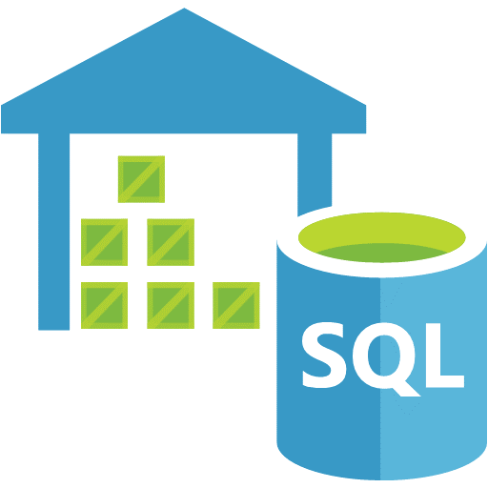









POV on Evolving Data Lake Architecture for Diverse Analytical Workloads
Governance
Raw
Encryption
Technical and Process Metadata
Users and Roles Management
Sharepoint
API
Ad-hoc
Excel
Archive
Canned Reports Server
Alerts
Staging Layer
SQL
Customer Support Data lake
OLAP Cube
RS
Hub & Spoke
Self service Report
eMails
SQL DW
SQL DBs
SSAS
Custom Ingestion Layer
Others
Semantic (Tabular)
Configuration driven orchestrating
Query
Apps
Talend/Data Factory/ Azure Functions
ML/AI Services
Portals
Federated Azure Analytics Warehouse

Slide 19
LatentView Data Engineering Capabilities

Slide 20
Data Engineering Capabilities Practiced at LatentView
Applications
Data Strategy
Data Lakes
Data Warehouse
Visualization
Decision management systems
IoT Applications
Data Monetization Roadmap
Cloud Strategy & Architecture
Architecture Evolution
Data Integration / Consolidation / Harmonization Framework
Optimizing BI Investments
Data Engineering
Capabilities
Technology
Engineering
Hadoop: Hive, HBase, MapReduce, PiG, HDFS, Phoenix
Spark – Scala, Python, Spark SQL
Flume, Kafka, NiFi, Sqoop
Spark Streaming, Storm
AWS, Azure, Kylo, Qubole, Databricks
Structure Data Flows
Ingest streaming & batch data
Data storage and data model
Batch and Real time processing
Real-time, Graph, Search & Iterative workloads
Orchestration
OCM & Managed Services
Organizational Change Mgmt
Governance
Maturity Assessments

Slide 21



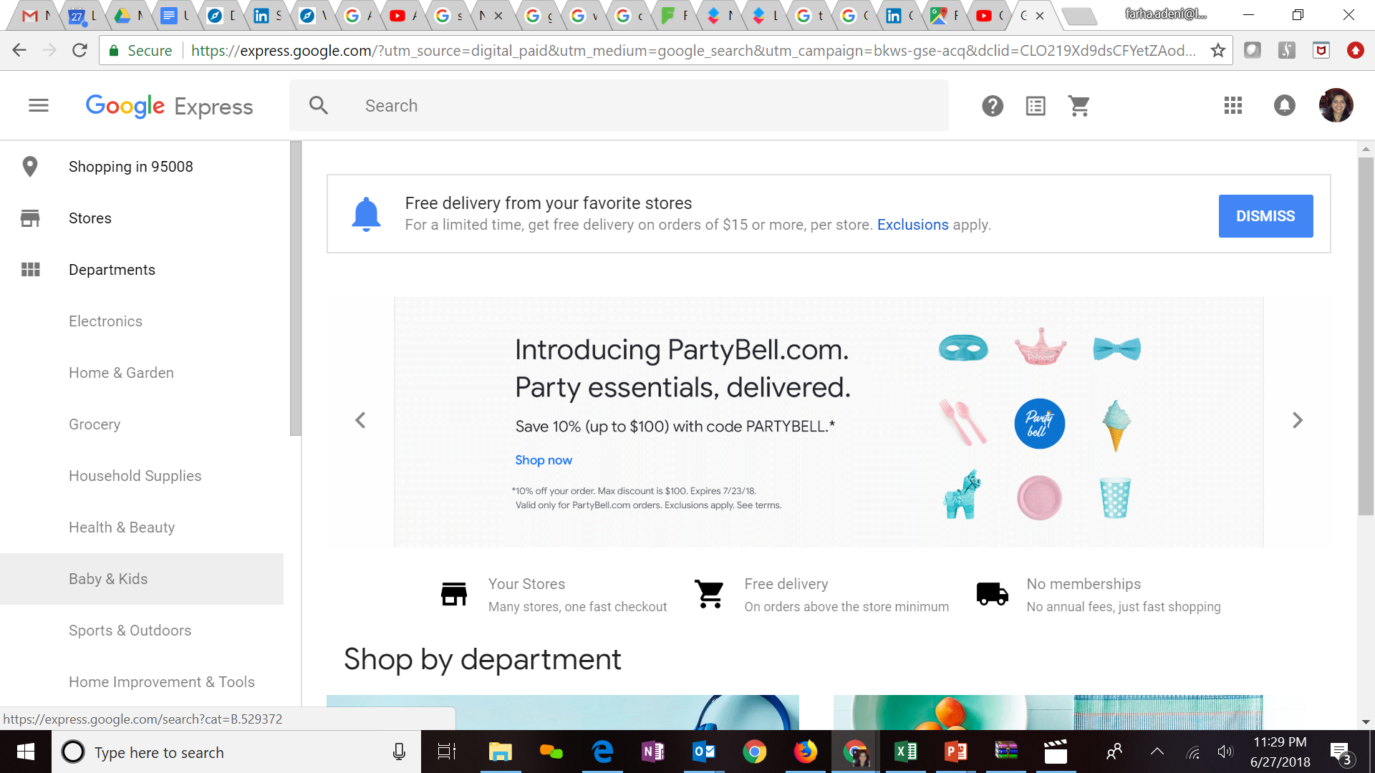




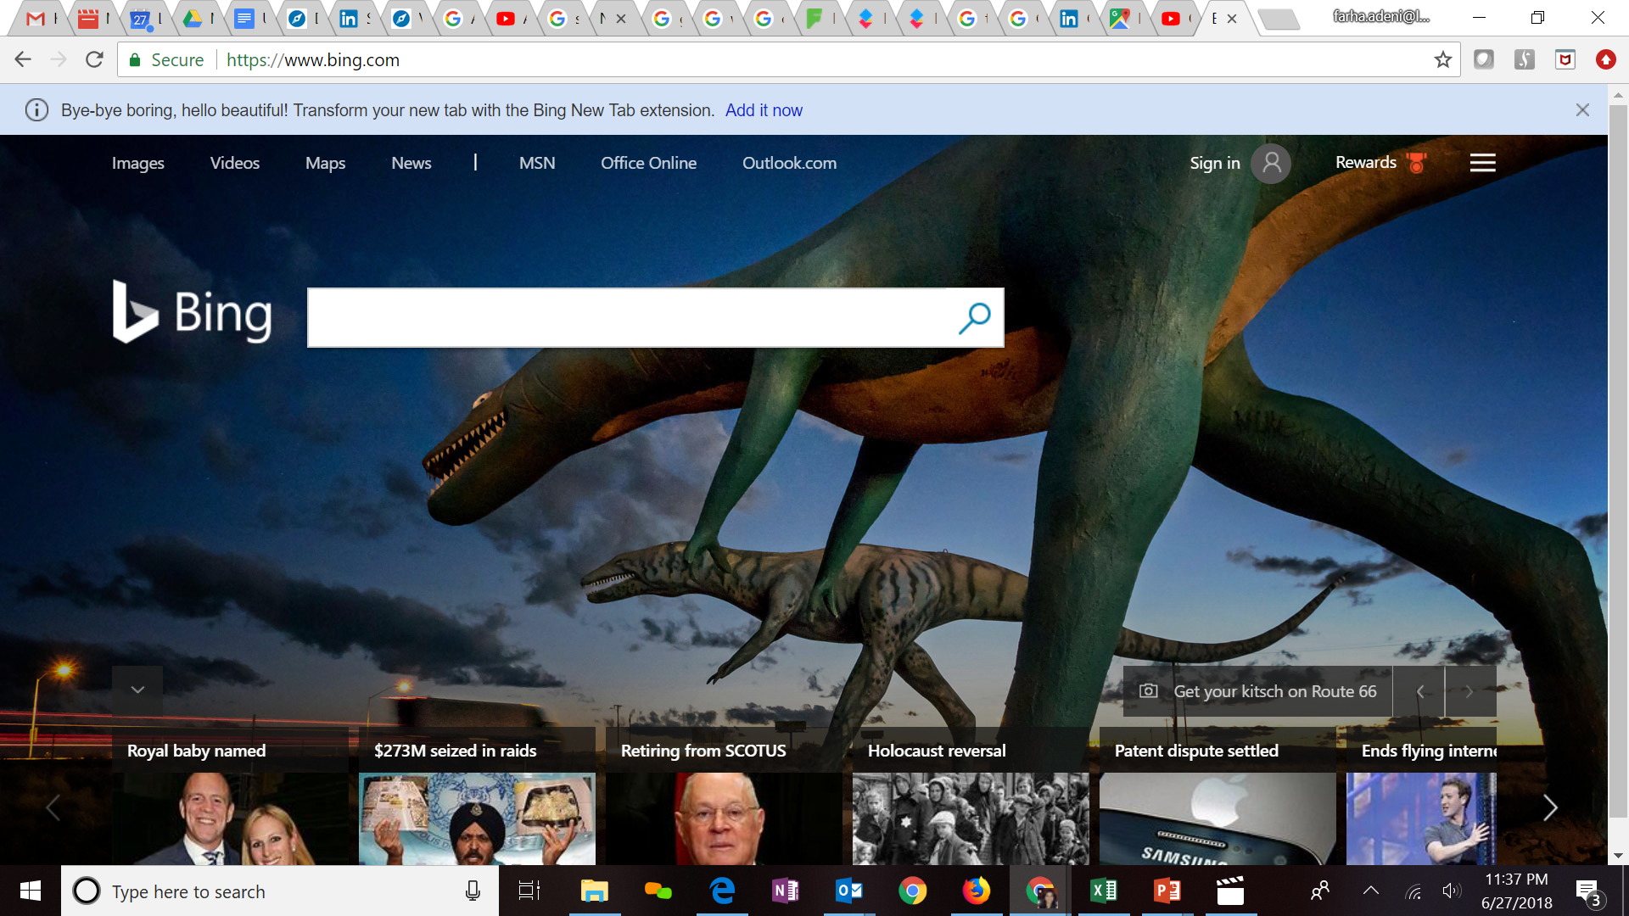

Expertise in Cloud platforms
Key Clients
LV is Advanced Analytics Consulting Partner
Key Presenters of AWS Re-Invent, Business Summit
40 AWS Business Professional Accredited resources
40 AWS Technical Professional Accredited resources
10 AWS trained personnel in Architecture/Sysops
60 TB cloud migration exercise completed in 3 months
Processing 500+ GB unstructured data per week
Multiple enterprise solutions deployment experience
Managed Analytics in AWS using Amazon ML, Cloudsearch, Kinesis, QuickSight etc.
Extensive experience in handling GCP products- AppScript, CloudSQL, Appmaker, Big Query etc. Deep Technical Capabilities to work in this platform
Multiple solutions deployment experience for Google projects
Managed Analytics in GCP using MapR, Cloud ML, Cloud dataflow, Google data studio, Cloud SQL
LatentView is a Microsoft Gold Analytics Partner
Model Automation Framework – LatentView scalable ML solution built in Azure hosted on Microsoft Appsource (link)
Key Participants of MS Tech-ED 2014, Azure Training
Managed Analytics in Azure using AzureML, PowerBI, Azure data factory, Azure Search, Azure data lake analytics etc.
Notes:
Q – Anup can you update some of the details

Slide 22
Case Studies

Slide 23
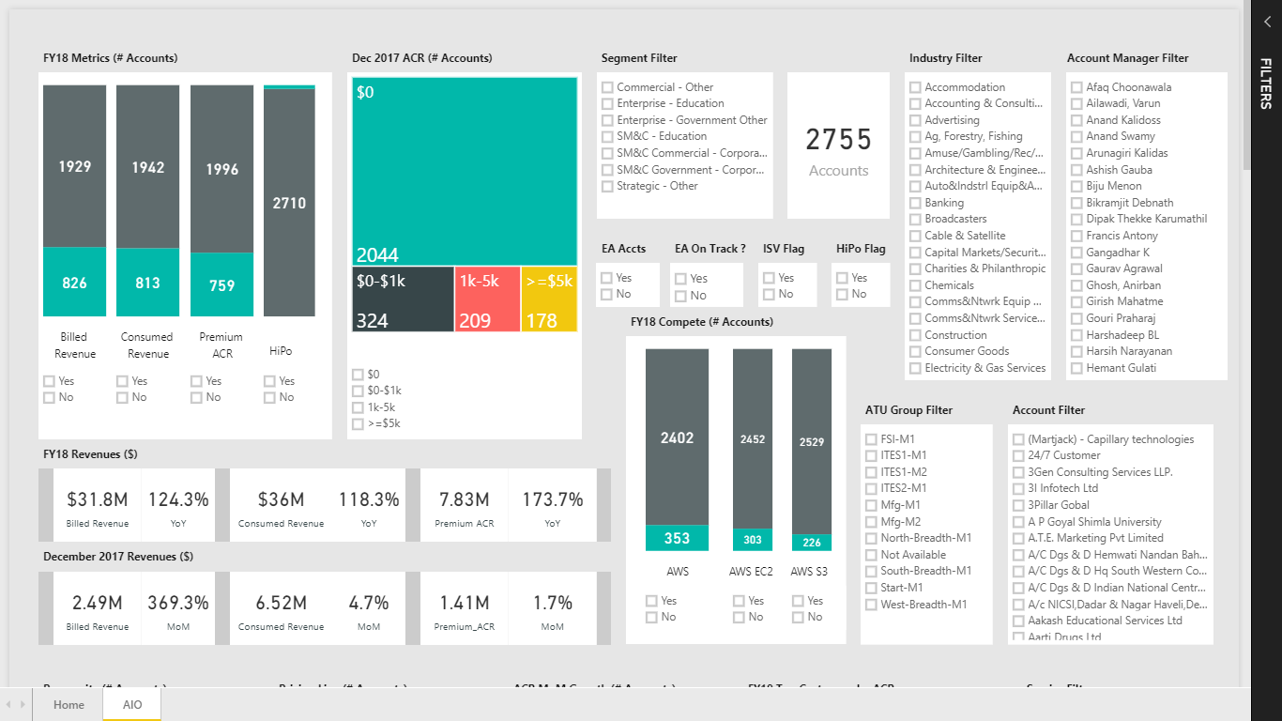
All-In-One Power BI Dashboard
A multinational technology client
The Problem: No single dashboard available to provide unified view on the cloud platform
The “Before” State
LatentView Solution
The “After” State
Data for cloud platform was scattered across different sources and reports making it difficult and complex for different teams to acquire relevant details to proceed with sales play and targeting exercises.
Consolidated all available targeting intelligence on cloud platform into a single dashboard to facilitate better data driven targeting and marketing . This aligned the Cloud Platform business to the FY18 goals
Huge amount of time savings across streams that enabled proactive actions
Removed the need for small ad hoc data requirements
Gives a strategic level viewpoint of Cloud Platform Business
Select the metrics on which the charts has to be filtered
Actionable parameters like Churn Risky, Growth Potential, Slow Growth and Immediate Action required accounts
Functionality to export data to excel for analysis

Slide 24








Improving Marketing Effectiveness through Purchase Intent Modeling
Leading Global Software Company
The Problem: Understanding changes in purchase intent is very critical in the highly dynamic technology industry
The “Before” State
LatentView Solution
The “After” State
Understanding the drivers of purchase intent & customer satisfaction was limited as not all possible behavioural combinations could be explored effectively
Built a Azure ML - cloud based modeling automation framework that integrates data sources, generates 400,000 model combinations to show the drivers of purchase intent through intuitive PowerBI visualizations
Quick understanding of the changing purchase intent & drivers helped marketing team make right tweaks to their spend value of $1.6 billion thereby improving marketing ROI by 3-4% on an average
Modeling Automation Framework
Marketing Spend - Scenario Testing
Survey
In-Time
AE - 1.9%
APE - 4.4%
Effect of spends being dark in Q1
Out-Time
AE - 2%
APE - 4.4%
Sales
Iterating with 400K combinations to get final model
Store final model parameters & associated data for all products
Live visualization of model results & scenario testing
Mktg. Spend decisions
Forecast:
PI is expected to decline to 38% in the next fiscal yr. Q1, but stay at a constant of 43% over the next 3 quarters of the fiscal year.
Ad Spends
Scenario: Going dark in Q1 – If we stop spending $41 M will results in a 5% drop in the Purchase Intent (sales proxy)

Slide 25












Data Harmonization for Efficient Digital Supply Chain
World’s Largest Entertainment production company
The Problem: For digital content that contributes $4 billion in revenue, the weak link in the supply chain is the nature of data pipeline which in the correct state is rigid & fragmented
The “Before” State
LatentView Solution
The “After” State
The supply chain starting from digital content request to going live is tracked using multiple silo data sources and requires skilled executives to monitor for revenue leaks
Built an data ecosystem from multiple disjointed unstructured and structured data sources by leveraging AWS cloud platform for big data, thus providing a monitoring platform
The solution helped in ensuring on-time delivery of the digital contents and thus, saved half a million dollar per year from revenue leaks
SQL Server
DMS
(ongoing replication)
S3 buckets
(encrypted)
Redshift
MarkLogic
GLUE
Tableau Server
Internet
Azure
Lambda
EC2 (Bastion Host)
DBA

Slide 26
Cloud Transformation for a major food distributor
Build ML POC
Setting up cloud data platform for analytics
Deep Learning
Enable Ad-hoc Querying
Increase sales and customer satisfaction
Enable analytics driven decision making process across the organization
Enhance effectiveness of product recommendations
Improve ad-hoc query experience for users
Goal
Sales personnel relying on intuition to make product recommendations
Legacy Analytics Infrastructure unable to scale for big data and compute intensive analytics applications (Hybrid Recommendation Engine)
Cuisine type not known for 35% of client base affecting product recommendations
Limited concurrency (50), slow performance and limited storage
Bottleneck
Hybrid Recommendation Engine using Client buying patterns, Client and Product characteristics proof of concept built for 2 Operating Companies. Accessible by Sales Personnel on mobile app through API
Full-scale transformation to cloud data platform
Deep learning solution to identify cuisine types from restaurant names. Prototyping done using Experimentation Sandbox, deployed in a Container and integrated with Scalable ML solution (Recommendation Engine)
Metrics engine as single source of truth for finance & sales metrics
Intelligent Data Bridge
Experimentation Sandbox
Metrics Engine
Solution
Discoverable Datasets
Scalable ML & API)
Optimized Workloads
Centralized Data Repository
Intelligent Ingestion
Workload aware Architecture
Container
Estimated 20% increase in value of new orders from existing customers
Approved rollout for all Operating Companies
Migrated 60TB of data in 3 months into the cloud data platform
Completed rollout of rec engine for all 70 Operating Companies
Enabled development of analytics apps
83% accuracy in cuisine classification
Nearly 100% coverage of customers for product recommendation
7 sec query response
250 concurrent users per minute
$125K savings per year in licensing cost
Impact

Slide 27
Thank You
ganesh.sankaran@latentview.com

